Slide 1
VARIANCE CASE NUMBER: WPVAR20-0006
(Reynolds Front Yard Setback Reduction)
Washoe County Board of Adjustment
December 3, 2020

Slide 2
Request
A variance request to allow the reduction in the front yard setback at two locations: at the front entryway area to a setback of 9’10 ½”, to facilitate the enclosure of the front entry and deck; and at the garage to a setback of 7’5 ½”, in order to facilitate expansion of the garage from a capacity of two cars to three cars.

Slide 3
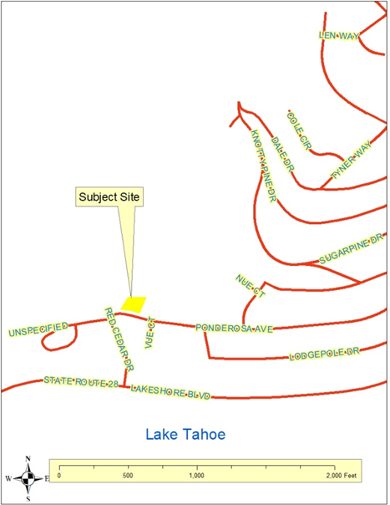
Vicinity Map

Slide 4
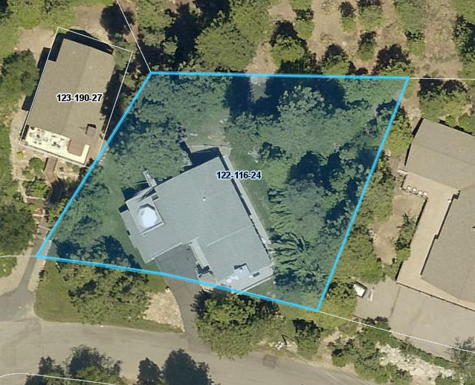
Overhead Photo

Slide 5
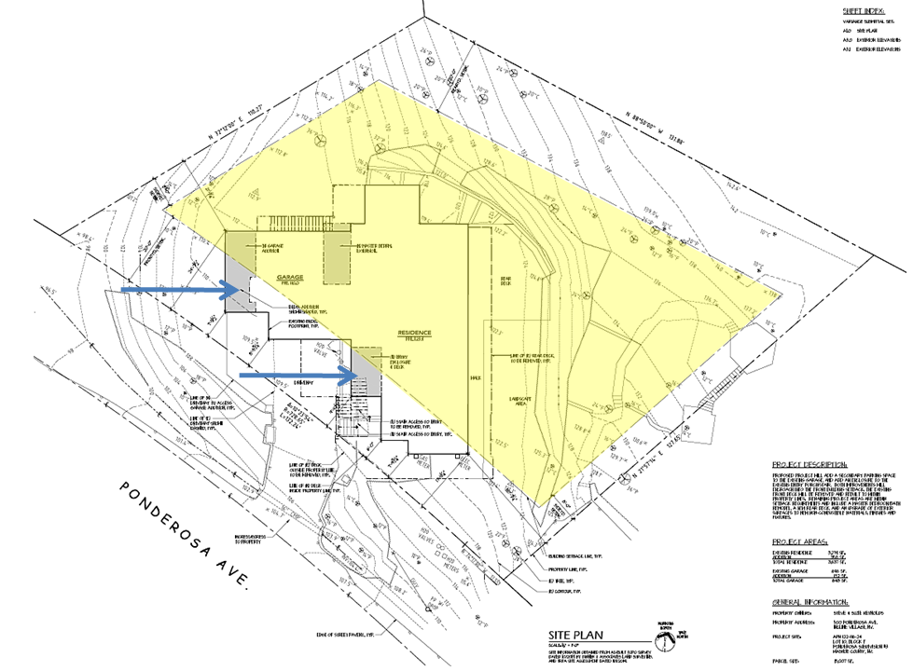
Proposed Site Plan

Slide 6
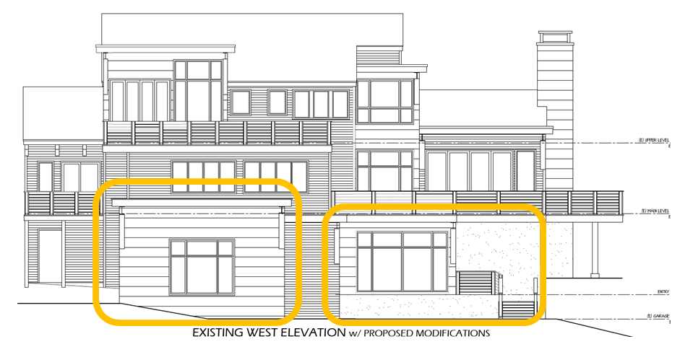
Proposed Additions

Slide 7
Variance Requirements / Findings of Fact
Nevada Revised Statues (NRS 278.300) limits the power of the Board of Adjustment to grant variances only under particular circumstances. The applicant has the responsibility to demonstrate that the subject property exhibits one or more of the following characteristics to demonstrate a hardship:
exceptional narrowness, shallowness, or shape of a specific piece of property; or
by reason of exceptional topographic conditions; or
other extraordinary and exceptional situation or condition of the piece of property.
If such a finding of fact can first be made, then the Board must also show that the strict application of the regulation would result in peculiar and exceptional practical difficulties to, or exceptional and undue hardships upon, the owner of the property.

Slide 8
Variance Findings of Fact
Exceptional Narrowness?
Minimum Lot dimension for the MDS zone is 80 feet.
Parcel is approximately 139 feet in width.
The subject parcel is not exceptionally narrow.

Slide 9
Variance Findings of Fact
Exceptional Shallowness?
Minimum Lot dimension for the MDS zone is 80 feet.
Parcel is approximately 174 feet in depth.
The subject parcel is not exceptionally shallow.

Slide 10
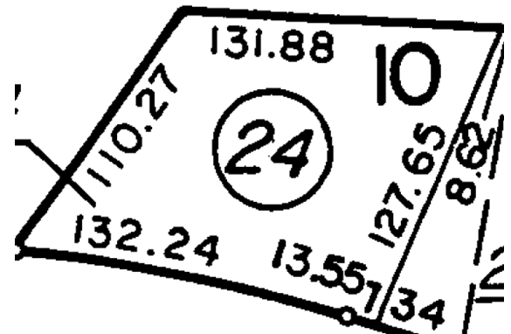
Variance Findings of Fact
Exceptional Shape?
Parcel is essentially rectangular.
The parcel is not exceptionally shaped.

Slide 11
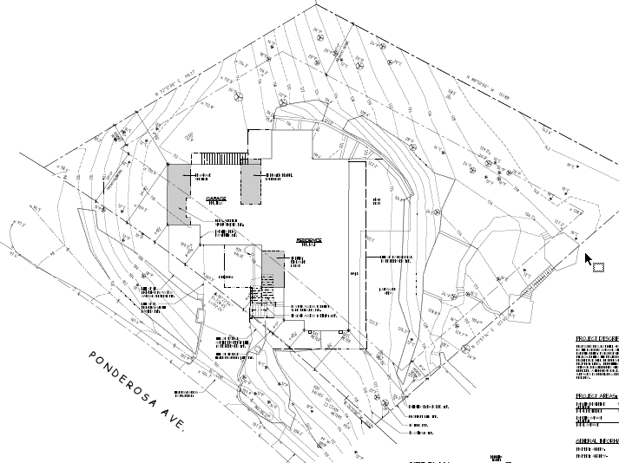
Variance Findings of Fact
Exceptional Topography?
The developable area of the subject parcel is has been graded to be essentially flat, with the previous development of the site.
The parcel does not contain exceptional topographic conditions, that inhibits the construction of a third-car garage.

Slide 12
Overall Variance Evaluation (Garage)
Extraordinary and exceptional situation or condition of the piece of property?
None exist.
Strict application of the Code is reasonable.
Other options exist to build a third-car garage within the setbacks.
  Move further north.
  Build on to rear of garage
  Reconfigure posts within current garage.

Slide 13
Overall Variance Evaluation (Entry)
Extraordinary and exceptional situation or condition of the piece of property?
Essentially the same analysis applies.
Encroachment is proposed to be reduced.
Enclosed entry may be a safety benefit in the Tahoe Area.

Slide 14
Anticipating a Question from BOA
Was applicant informed early in the evaluation process that there was a likelihood of a recommendation of denial?
Yes, staff had several long conversations with the applicants representative and recommended that the application be withdrawn.

Slide 15
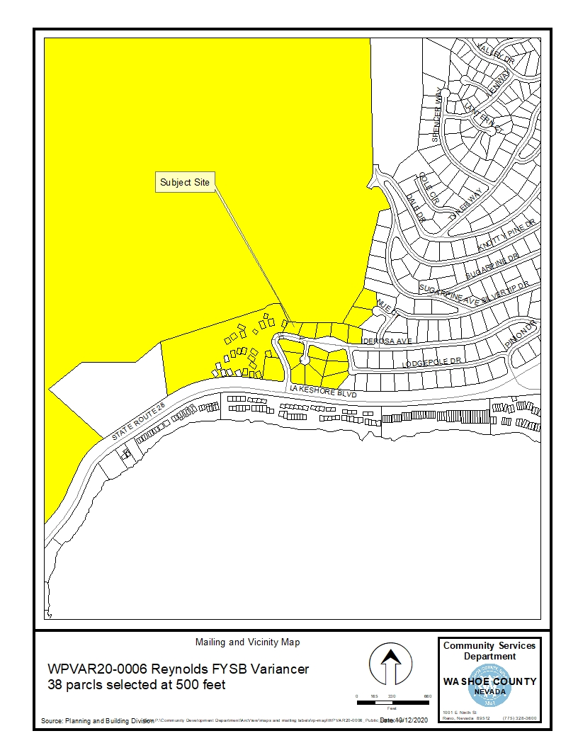
Public Notice & CAB
Notice sent to 38 affected property owners
The CAB met on November 2 and recommended that the applicant reach out to surrounding property owners, and expressed concern that there may or may not be a hardship associated with the project site.

Slide 16
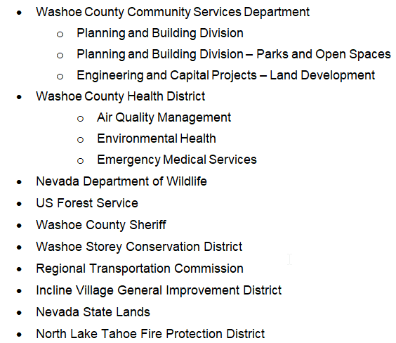
Reviewing Agencies

Slide 17
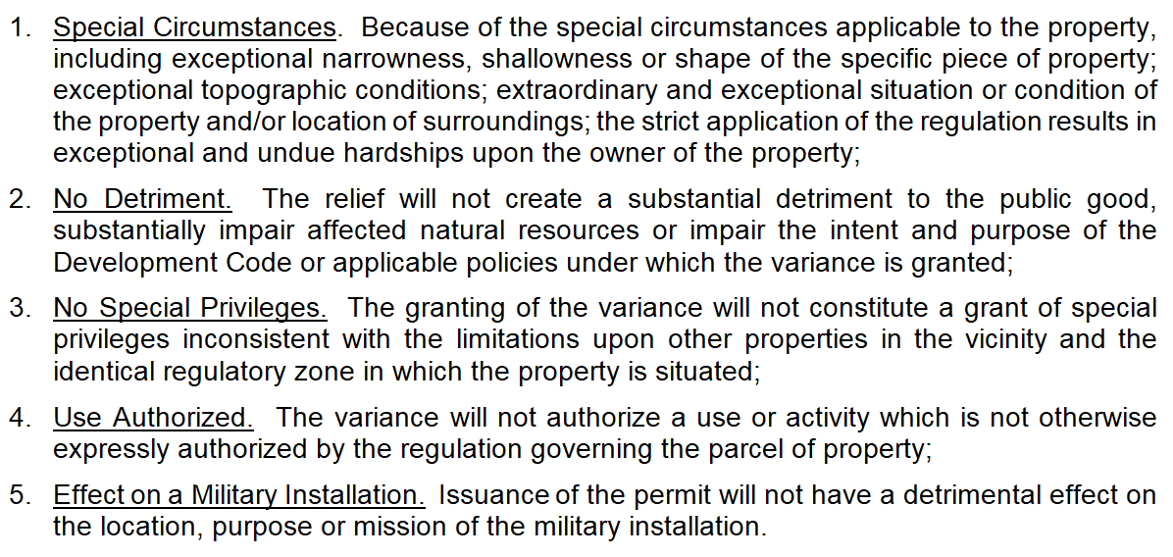
Variance Findings

Slide 18
Possible Motion
I move that, after giving reasoned consideration to the information contained in the staff report and information received during the public hearing, the Washoe County Board of Adjustment:
PARTIALLY approve Variance Case Number WPVAR20-0006 for John S. “Steve” Reynolds, to facilitate the enclosure of the front entry and deck by reducing the front setback from 20’ to a setback of 9’10 ½” with the Conditions of Approval included as Exhibit A for this matter, having made all four required findings in accordance with Washoe County Development Code Section 110.804.25.
AND
PARTIALLY deny Variance Case Number WPVAR20-0006 for John S. “Steve” Reynolds, to facilitate expansion of the garage from a capacity of two-cars to three cars by reducing the front setback from 20’ to a setback of 7’5 ½”, being unable to make all four required findings in accordance with Washoe County Development Code Section 110.804.25.

Slide 19
Questions?

